Slide 1
A Practical Introduction to Blockchain with Python

Slide 2
Block Chain technology
Blockchain is arguably one of the most significant and disruptive technologies that came into existence since the inception of the Internet. It's the core technology behind Bitcoin and other crypto-currencies that drew a lot of attention in the last few years.
As its core, a blockchain is a distributed database that allows direct transactions between two parties without the need of a central authority. This simple yet powerful concept has great implications for various institutions such as banks, governments and marketplaces, just to name a few. Any business or organization that relies on a centralized database as a core competitive advantage can potentially be disrupted by blockchain technology.

Slide 3
How does it started
It all started with a white paper released in 2008 by an unknown person or entity using the name Satoshi Nakamoto. The white paper was titled “Bitcoin: A Peer-to-Peer Electronic Cash System” and it laid the foundation of what later became known as Blockchain. In the original Bitcoin white paper, Satoshi described how to build a peer-to-peer electronic cash system that allows online payments to be sent directly from one party to another without going through a centralized institution.
This system solves an important problem in digital money called double-spend
Code Link:
https://satoshi.nakamotoinstitute.org/code/

Slide 4
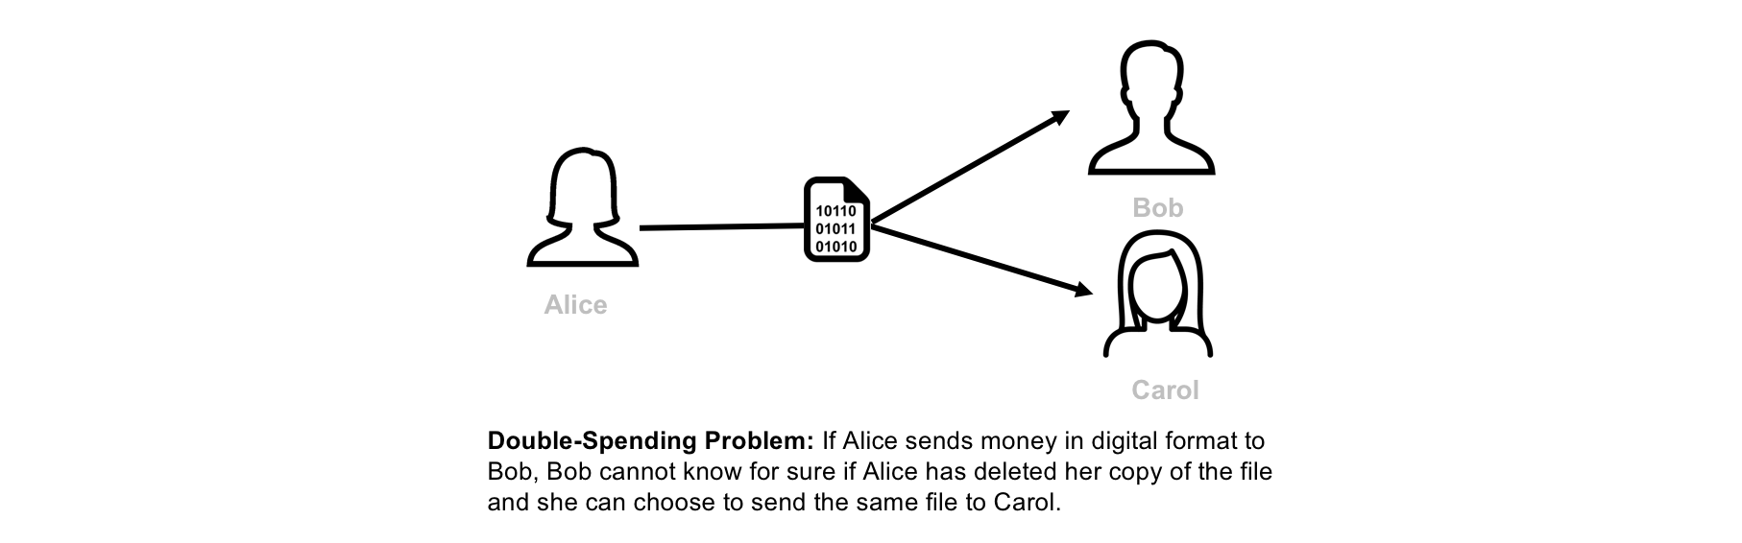
What is Double-Spending?

Slide 5
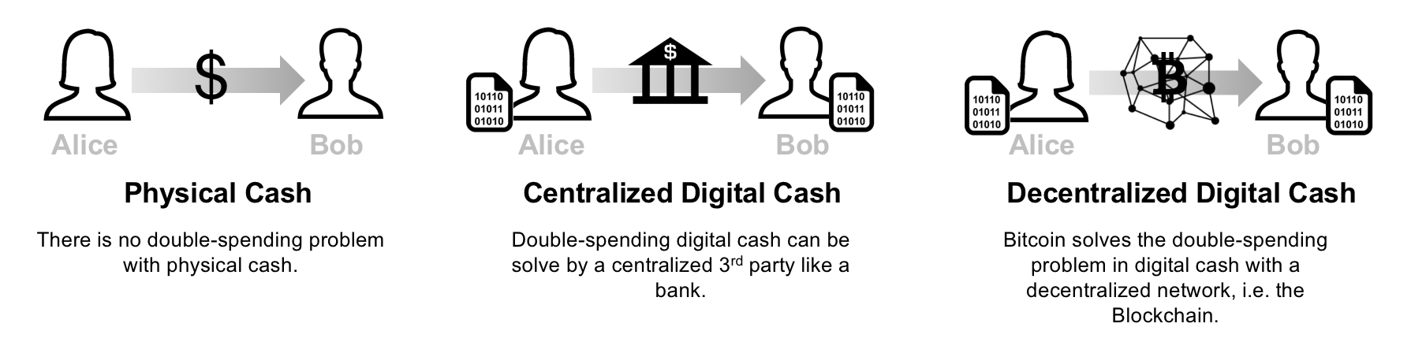
Bitcoin: A Decentralized Solution for the Double-Spending Problem

Slide 6
Bitcoin: A Decentralized Solution for the Double-Spending Problem cont.
To solve the double-spending problem, Satoshi proposed a public ledger, i.e., Bitcoin’s blockchain to keep track of all transactions in the network. Bitcoin’s blockchain has the following characteristics:
Distributed: The ledger is replicated across a number of computers, rather than being stored on a central server. Any computer with an internet connection can download a full copy of the blockchain.
Cryptographic: Cryptography is used to make sure that the sender owns the bitcoin that she's trying to send, and to decide how the transactions are added to the blockchain.
Immutable: The blockchain can be changed in append only fashion. In other words, transactions can only be added to the blockchain but cannot be deleted or modified.
Uses Proof of Work (PoW): A special type of participants in the network called miners compete on searching for the solution to a cryptographic puzzle that will allow them to add a block of transactions to Bitcoin’s blockchain. This process is called Proof of Work and it allows the system to be secure

Slide 7
Sending bitcoin money
Step 1 (one-time effort): Create a bitcoin wallet. For a person to send or receive bitcoins, she needs to create a bitcoin wallet. A bitcoin wallet stores 2 pieces of information: A private key + public key. The private key is a secret number that allows the owner to send bitcoin to another user, or spend bitcoins on services that accept them as payment method. The public key is a number that is needed to receive bitcoins. The public key is also referred to as bitcoin address (not entirely true, but for simplicity we will assume that the public key and the bitcoin address are the same). Note that the wallet doesn’t store the bitcoins themselves. Information about bitcoins balances are stored on the Bitcoin’s blockchain.
Step 2: Create a bitcoin transaction. If Alice wants to send 1 BTC to Bob, Alice needs to connect to her bitcoin wallet using her private key, and create a transaction that contains the amount of bitcoins she wants to send and the address where she wants to send them (in this case Bob’s public address).
Step 3: Broadcast the transaction to Bitcoin’s network. Once Alice creates the bitcoin transaction, she needs to broadcast this transaction to the entire Bitcoin’s network.
Step 4: Confirm the transaction. A miner listening to Bitcoin’s network authenticates the transaction using Alice's public key, confirms that Alice has enough bitcoins in her wallet (in this case at least 1 BTC), and adds a new record to Bitcoin’s Blockchain containing the details of the transaction.
Step 5: Broadcast the blockchain change to all miners. Once the transaction is confirmed, the miner should broadcast the blockchain change to all miners to make sure that their copies of the blockchain are all in sync.
2. A Technical Deep Dive on Blockchain
The goal of this section is to go deeper into the technical building blocks that power the blockchain. We will cover public key cryptography, hashing functions, mining and security of the blockchain.

Slide 8
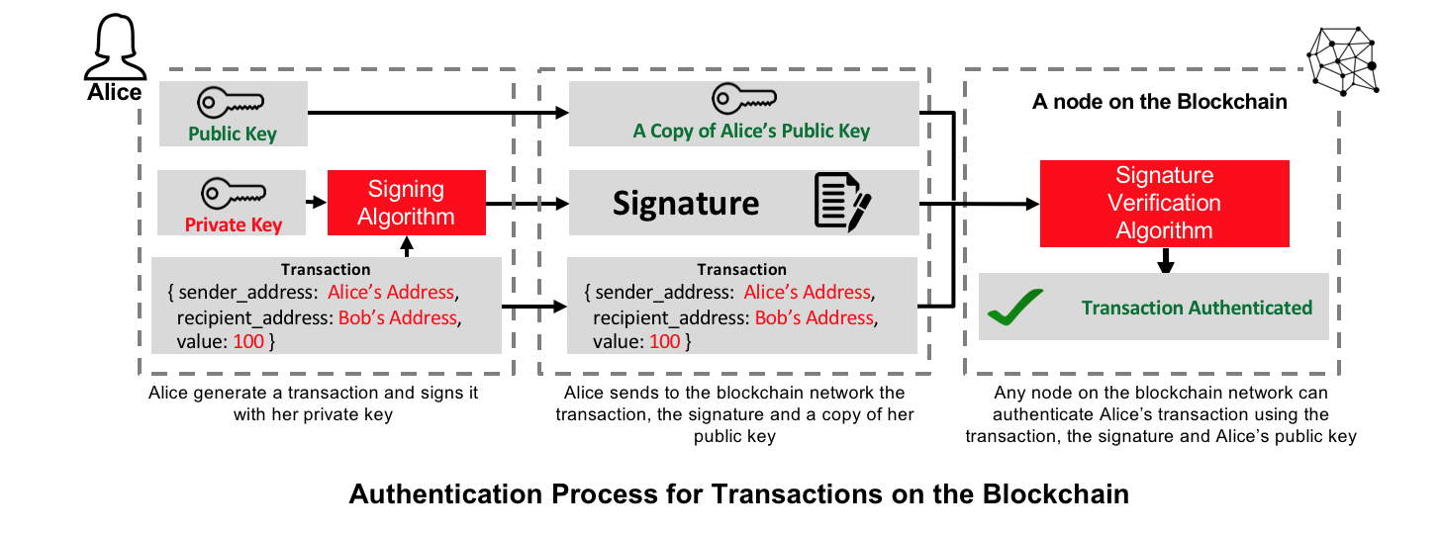
Public Key Cryptography

Slide 9
Public Key Cryptography
Public-key cryptography, or asymmetrical cryptography, is any cryptographic system that uses pairs of keys: public keys which may be disseminated widely, and private keys which are known only to the owner. This accomplishes two functions: authentication, where the public key verifies a holder of the paired private key sent the message, and encryption, where only the paired private key holder can decrypt the message encrypted with the public key. [1]
RSA and Elliptic Curve Digital Signature (ECDSA) are the most popular public-key cryptography algorithms.
In the case of Bitcoin, ECDSA algorithm is used to generate Bitcoin wallets. Bitcoin uses a variety of keys and addresses, but for the sake of simplicity, we will assume in this blog post that each Bitcoin wallet has one pair of private/public keys and that a Bitcoin address is the wallet's public key. I recommend this article, if you're interested in the complete technical details of Bitcoin wallets.
To send or receive BTCs, a user starts by generating a wallet which contains a pair of private and public keys. If Alice wants to send Bob some BTCs, she creates a transaction in which she enters both her and Bob's public keys, and the amount of BTCs she wants to send. She then sign the transaction using her private key. A computer on the blockchain uses Alice's public key to verify that the transaction is authentic and adds the transaction to a block that will be later added to the blockchain.

Slide 10
Hashing Functions and Mining
All Bitcoin transactions are grouped in files called blocks. Bitcoin adds a new block of transactions every 10 minutes. Once a new block is added to the blockchain, it becomes immutable and can't be deleted or modified. A special group of participants in the network called miners (computers connected to the blockchain) are responsible for creating new blocks of transactions. A miner has to authenticate each transaction using the sender's public key, confirm that the sender has enough balance for the requested transaction, and add the transaction to the block. Miners are completely free to choose which transactions to include in the blocks, therefore the senders need to include a transaction fee to incentivise the miners to add their transactions to the blocks.
For a block to be accepted by the blockchain, it needs to be "mined". To mine a block, miners need to find an extremely rare solution to a cryptographic puzzle. If a mined block is accepted by the blockchain, the miner receive a reward in bitcoins which is an additional incentive to transaction fees. The mining process is also referred to as Proof of Work (PoW), and it's the main mechanism that enables the blockchain to be trustless and secure (more on blockchain security later).

Slide 11
Hashing and Blockchain's Cryptographic Puzzle
Bitcoins uses a cryptographic hash function called SHA-256. SHA-256 is applied to a combination of the block's data (bitcoin transactions) and a number called nonce. By changing the block data or the nonce, we get completely different hashes. For a block to be considered valid or "mined", the hash value of the block and the nonce needs to meet a certain condition. For example, the four leading digits of the hash needs to be equal to "0000". We can increase the mining complexity by making the condition more complex, for example we can increase the number of 0s that the hash value needs to start with.
The cryptograhic puzzle that miners need to solve is to find a nonce value that makes the hash value satisfies the mining condition. You can use the app below to simulate block mining. When you type in the "Data" text box or change the nonce value, you can notice the change in the hash value. When you click the "Mine" button, the app starts with a nonce equals to zero, computes the hash value and checks if the leading four digits of the hash value is equal to "0000". If the leading four digits are not equal to "0000", it increments the nonce by one and repeats the whole process until it finds a nonce value that satisify the condition. If the block is considered mined, the background color turns green.

Slide 12
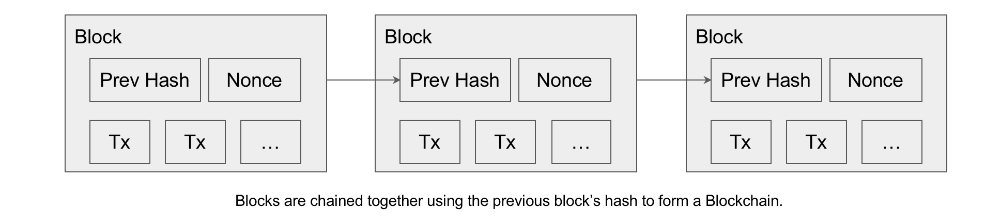
From Blocks to Blockchain

Slide 13
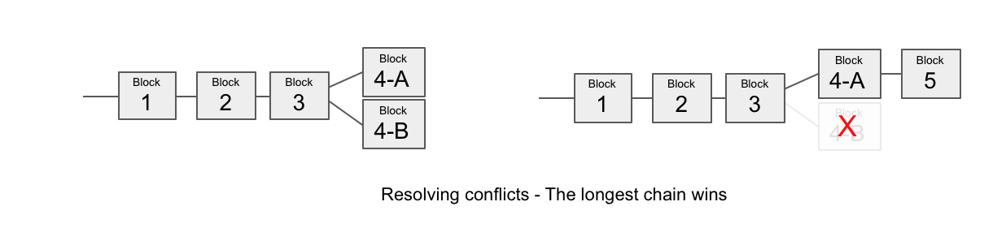
Adding Blocks to the Blockchain

Slide 14
Blockchain and Double-Spending
In this section, we will cover the most popular ways for performing double-spending attacks on the blockchain, and the measures that users should take to prevent damages from them.
Race Attack
An attacker sends the same coin in rapid succession to two different addresses. To prevent from this attack, it is recommended to wait for at least one block confirmation before accepting the payment.
Finney Attack
An attacker pre-mines a block with a transaction, and spends the same coins in a second transaction before releasing the block. In this scenario, the second transaction will not be validated. To prevent from this attack, it is recommended to wait for at least 6 block confirmations before accepting the payment.
Majority Attack (also called 51% attack)
In this attack, the attacker owns 51% of the computing power of the network. The attacker starts by making a transaction that is brodcasted to the entire network, and then mines a private blockchain where he double-spends the coins of the previous transaction. Since the attacker owns the majority of the computing power, he is guaranteed that he will have at some point a longer chain than the "honest" network. He can then release his longer blockchain that will replace the "honest" blockchain and cancel the original transaction. This attack is highly unlikely, as it’s very expensive in blockchain networks like Bitcoin.

Slide 15
A Blockchain Implementation in Python
In this section, we will implement a basic blockchain and a blockchain client using Python. Our blockchain will have the following features:
Possibility of adding multiple nodes to the blockchain
Proof of Work (PoW)
Simple conflict resolution between nodes
Transactions with RSA encryption
Our blockchain client will have the following features:
Wallets generation using Public/Private key encryption (based on RSA algorithm)
Generation of transactions with RSA encryption
We will also implement 2 dashboards:
"Blockchain Frontend" for miners
"Blockchain Client" for users to generate wallets and send coins

Slide 16
Proof-of-work system
A proof-of-work (PoW) system (or protocol, or function) is an economic measure to deter denial of service attacks and other service abuses such as spam on a network by requiring some work from the service requester, usually meaning processing time by a computer.
The concept was invented by Cynthia Dwork and Moni Naor as presented in a 1993 journal article.^{[1]} The term "Proof of Work" or POW was first coined and formalized in a 1999 paper by Markus Jakobsson and Ari Juels.^{[2]} An early example of the proof-of-work system used to give value to a currency is the shell money of the Solomon Islands

Slide 17
List of proof-of-work functions
Integer square root modulo a large prime^{[1]}
Weaken Fiat–Shamir signatures^{[1]}
Ong–Schnorr–Shamir signature broken by Pollard^{[1]}
Partial hash inversion^{[11][12][2]} This paper formalizes the idea of a proof of work (POW) and introduces "the dependent idea of a bread pudding protocol", a "re-usable proof of work" (RPOW) system.^{[13]} as Hashcash
Hash sequences^{[14]}
Puzzles^{[15]}
Diffie–Hellman-based puzzle^{[16]}
Moderate^{[6]}
Mbound^{[7]}
Hokkaido^{[8]}
Cuckoo Cycle^{[9]}
Merkle tree based^{[17]}
Guided tour puzzle protocol^{[10]}

Slide 18
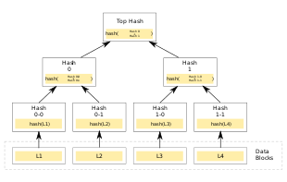
Merkle tree

Slide 19
Implementation
In cryptography and computer science, a hash tree or Merkle tree is a tree in which every leaf node is labelled with the hash of a data block and every non-leaf node is labelled with the cryptographic hash of the labels of its child nodes. Hash trees allow efficient and secure verification of the contents of large data structures. Hash trees are a generalization of hash lists and hash chains.
Demonstrating that a leaf node is a part of a given binary hash tree requires computing a number of hashes proportional to the logarithm of the number of leaf nodes of the tree;^{[1]} this contrasts with hash lists, where the number is proportional to the number of leaf nodes itself
A hash tree is a tree of hashes in which the leaves are hashes of data blocks in, for instance, a file or set of files. Nodes further up in the tree are the hashes of their respective children. For example, in the picture hash 0 is the result of hashing the concatenation of hash 0-0 and hash 0-1. That is, hash 0 = hash( hash 0-0 + hash 0-1 ) where + denotes concatenation

